Slide 1




L-Dominance: An Approximate-Domination Mechanism
for Adaptive Resolution of Pareto Frontiers
Braden J. Hancock
Advised by:
Christopher A. Mattson
Brigham Young University
Dept. of Mechanical Engineering
Honors Thesis Defense
3 March 2015

Slide 2
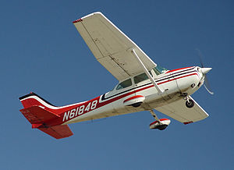
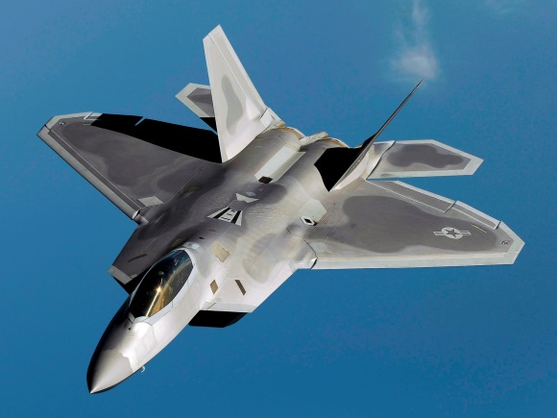
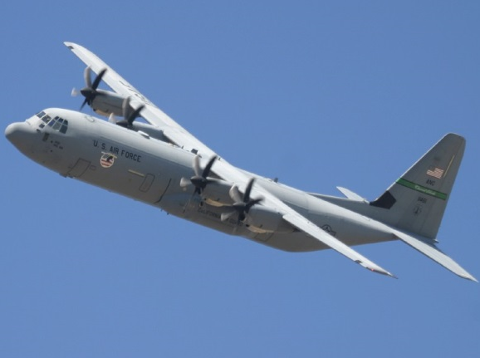
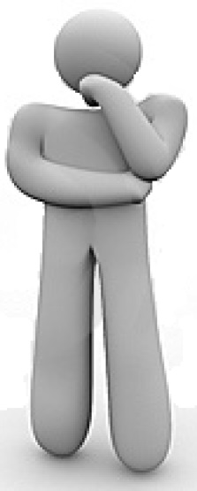
Motivation
Notes:
fast like an F-22 fighter
inexpensive like a personal plane, and
with a large payload like a C-130

Slide 3
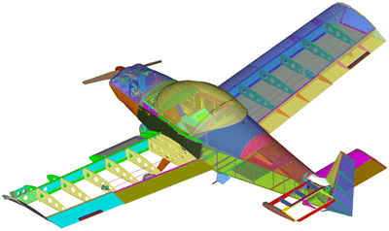
Tradeoffs
Radar Footprint
Payload Size
Manufacturability
Fuel Efficiency
Maximum Speed
Backwards Compatibility
Cost
Carbon Emissions

Slide 4
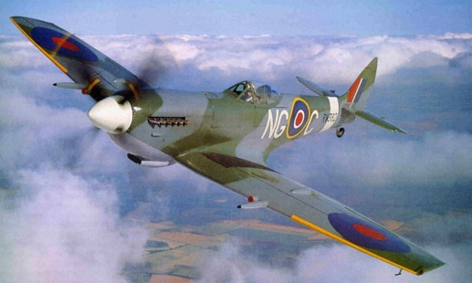
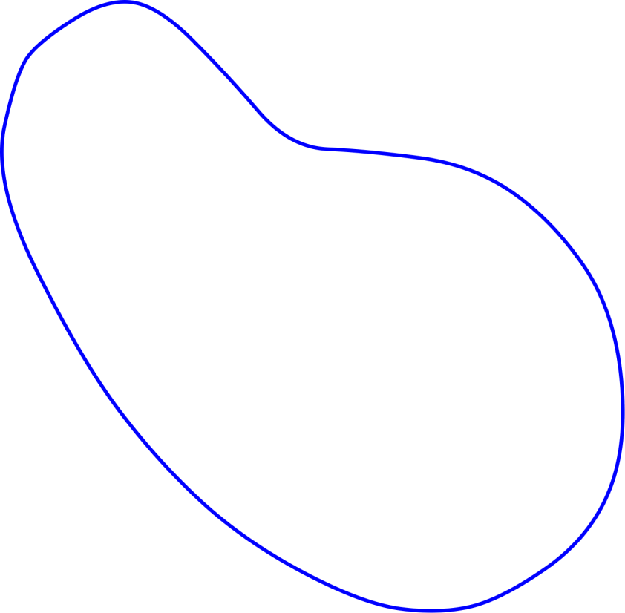
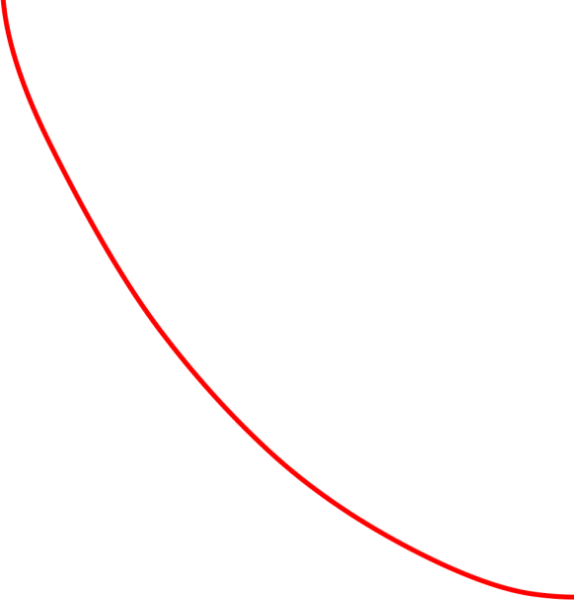
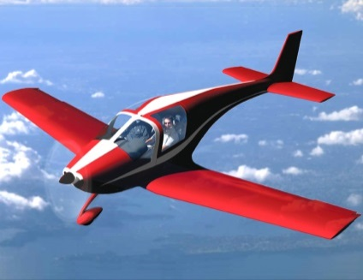
Pareto Frontiers
Feasible Design Space
Pareto Frontier
Weight
Ideal Location
(infeasible)
Cost
Notes:
Pick out red later

Slide 5

Outline
Motivation
Existing Mechanism: ε-Dominance
Proposed Mechanism: L-Dominance
Analytical Comparison
Simulation Results
Conclusions
Notes:
Eliminate pictures

Slide 6
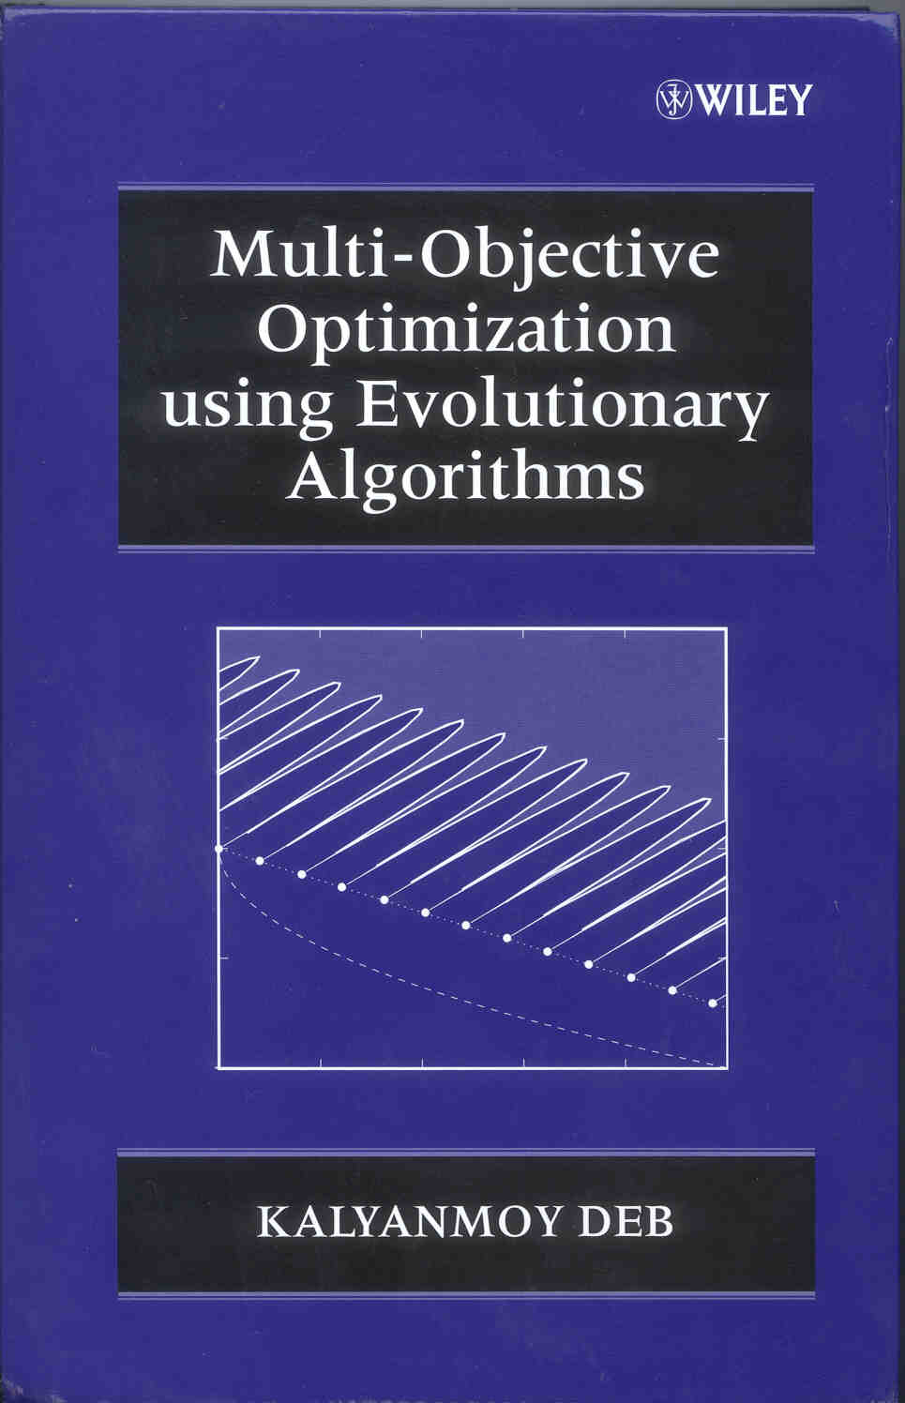
Goals of EMO
The three goals of Evolutionary Multi-Objective Optimization (EMO):
Converge on the true Pareto frontier
Maintain diversity
Do so at a reasonable cost
Deb, Kalyanmoy. Multi-objective optimization using evolutionary algorithms. Vol. 16. John Wiley & Sons, 2001.

Slide 7
Definitions
Distinction within EMO:
Method – Complete, standalone algorithm for performing multi-objective optimization
(e.g., NSGA-II, SPEA, particle swarm)
Mechanism – An additional series of calculations performed within an algorithm to improve performance.
(e.g., ε-Dominance, L-Dominance)

Slide 8
ε-Dominance
Dominated Solution
Pareto Frontier
D
A
N
ε-box
E
B
G
F
ε
P
ε
ε
Y
C
ε

Slide 9
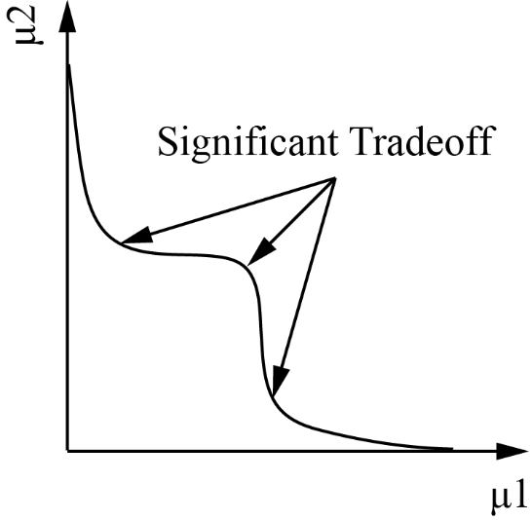
Pareto Knees
Objective 2
Pareto Knees
Objective 1

Slide 10
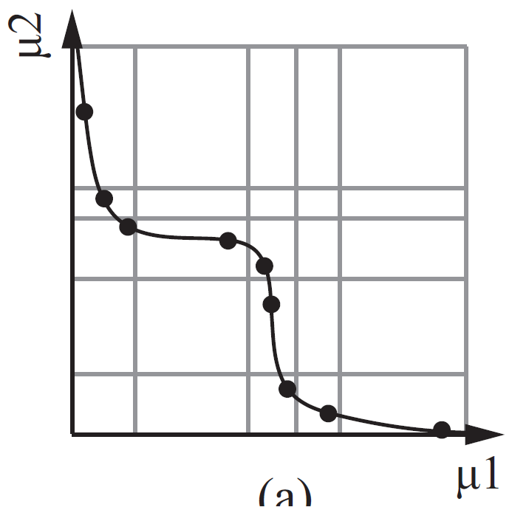
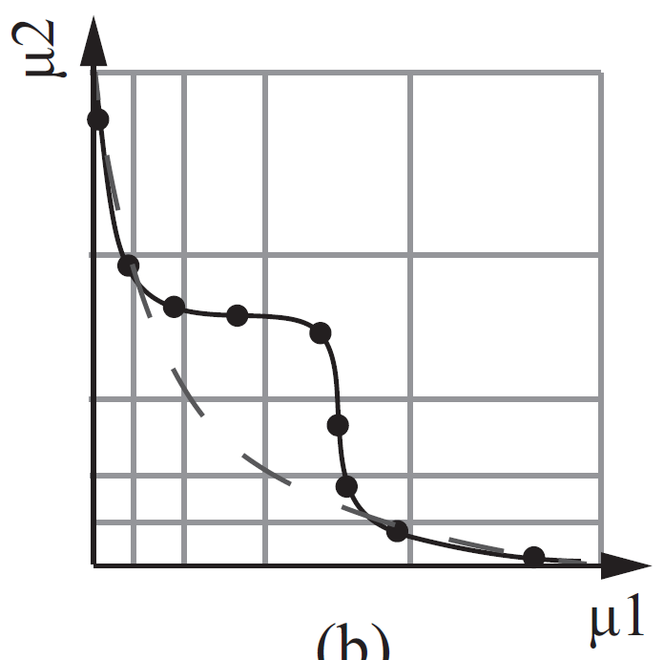
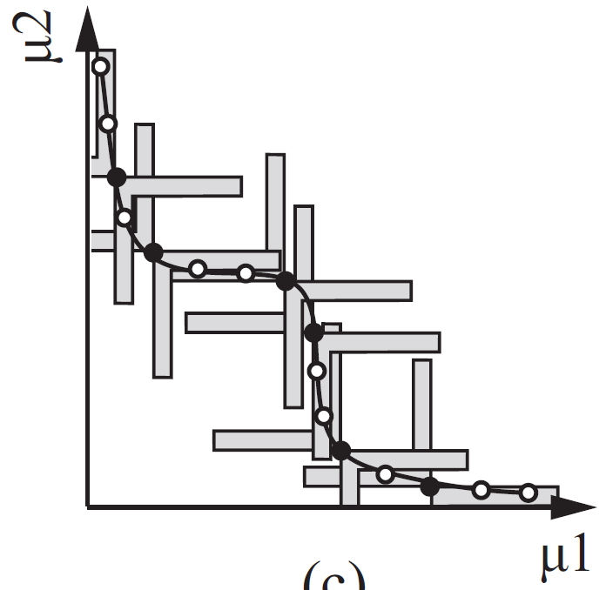
ε-Dominance Variations
Adaptive Rectangle Archiving
Pareto-Adaptive
ε-Dominance
Smart Pareto Filter

Slide 11
Our Contribution
Mechanisms that satisfy EMO goals
Mechanisms that exploit Pareto knees
Adaptive Rectangle Archiving
ε-Dominance
L-Dominance
Pareto-Adaptive
ε-Dominance
Smart Pareto Filter

Slide 12
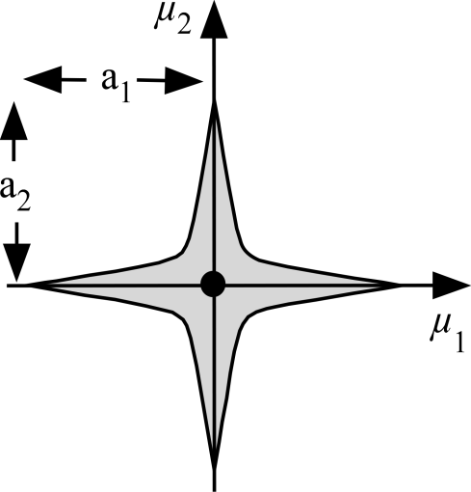
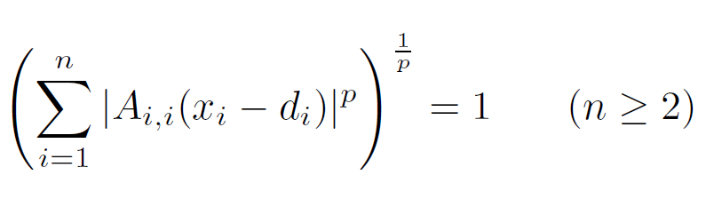
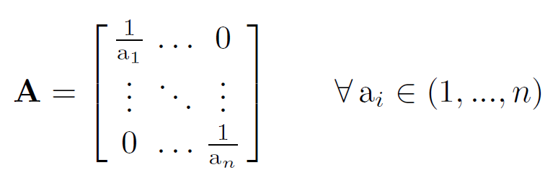
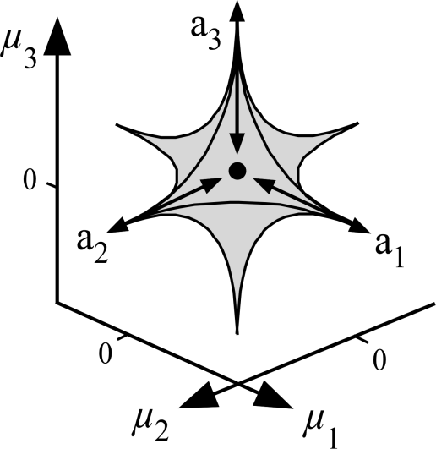
Lamé Curves
p
(1)
p
(2)

Slide 13
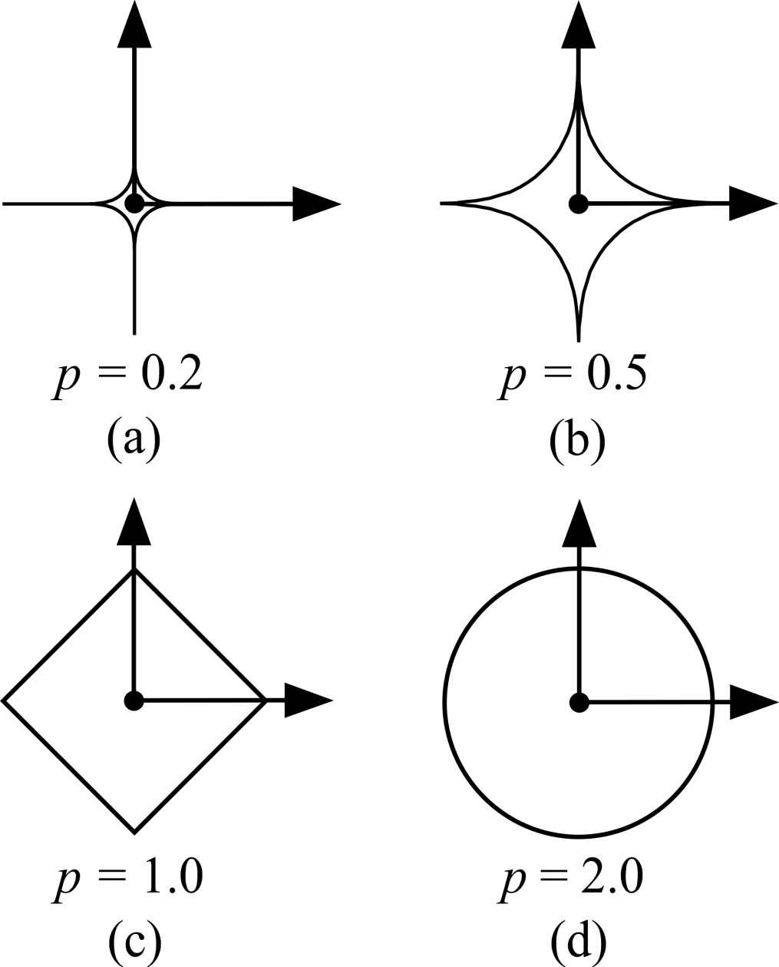
Lamé Curves

Slide 14
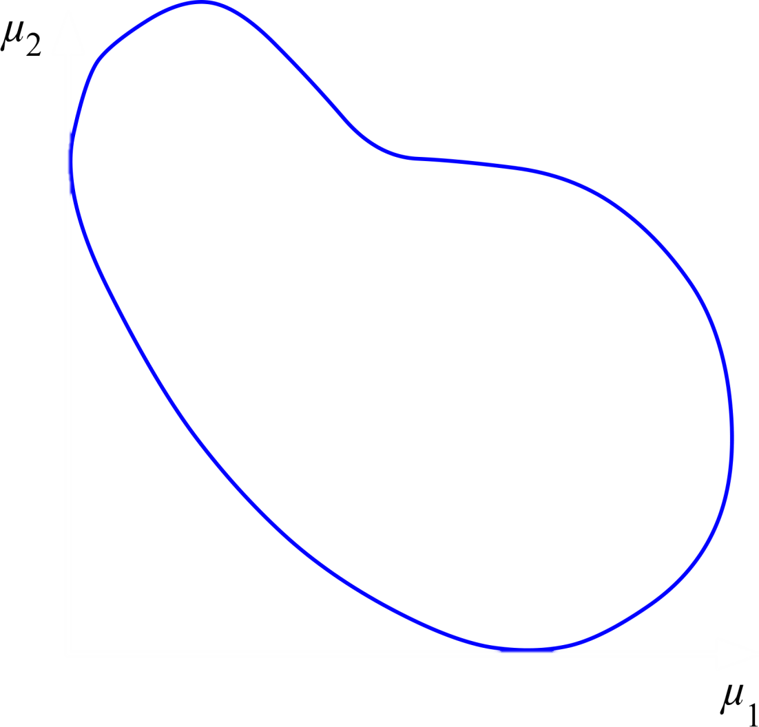

L-Dominance

Slide 15

Analytical Comparison
ε-Dominance
L-Dominance
Convergence
Guarantee
Diversity
Maintenance
Reasonable
Cost

Slide 16
Advantages
Greater resolution of Pareto knees
Guaranteed minimum distance b/w solutions:

Slide 17
Disadvantages
Less intuitive parameter selection (e.g., p)
Little difference if equal distribution is desired
ε-Dominance
L-Dominance
(p = 2)

Slide 18
Simulation Setup
ε-MOEA
“L-MOEA”
Initial Population
Initial Population
Populate Archive
Populate Archive
Mate Population & Archive
Mate Population & Archive
ε-Dominance Check
L-Dominance Check
Update Archive
Update Archive

Slide 19
Simulation Setup
Input Parameters
Input Parameters
L-MOEA
ε-MOEA
Knee Resolution X
Knee Resolution X
?
Cost of L-MOEA
=
Cost of ε-MOEA

Slide 20
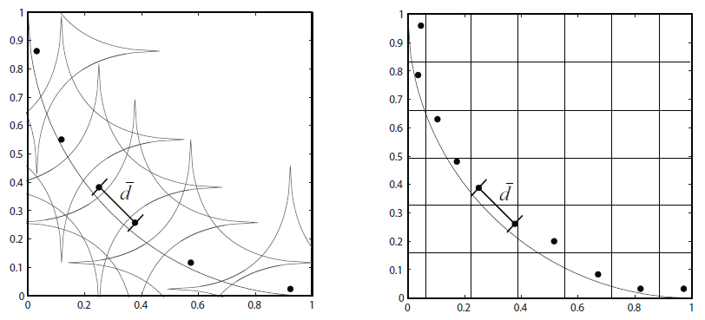
Simulation Setup
L-MOEA
ε-MOEA

Slide 21
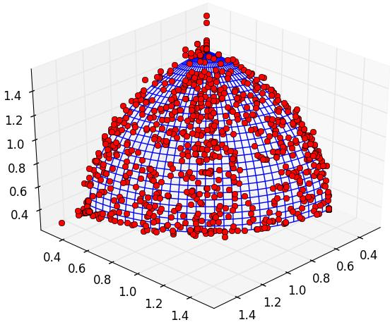
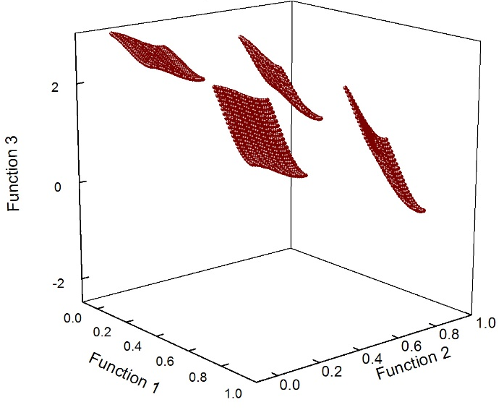
Simulation Problems
(2D, 3D, 4D)
Circle
DTLZ2
DTLZ7
(convex)
(concave)
(disjoint)

Slide 22
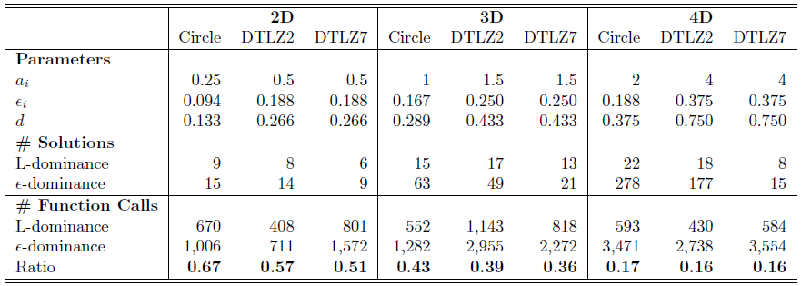
Simulation Results
Dimensionality
Advantage of L-MOEA

Slide 23
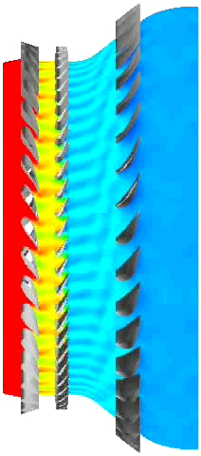
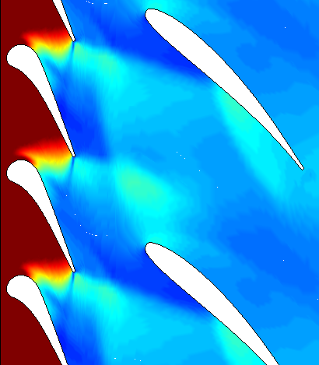
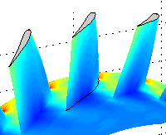
Engineering Application
Turbine Airfoil Optimization with
3D Unsteady RANS Analysis (CFD)
6 hours/function call
7 objectives
Estimated reduction in computational cost:
35x

Slide 24
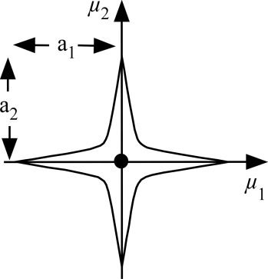
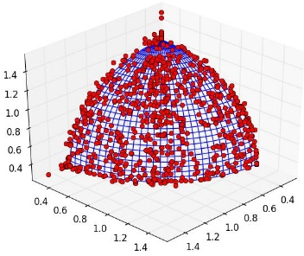
Conclusions
1) ε-Dominance provides guaranteed convergence and diversity preservation at a reasonable computational cost.
ε
ε
2) L-Dominance maintains ε-dominance benefits while increasing Pareto knee exploitation.
3) L-Dominance is recommended for use where variable resolution is desired, especially in high-dimensional problems.
35x
Notes:
Line up graphics

Slide 25
Previous Presentations
Publications
B. Hancock, T. Nysetvold, C. Mattson, “L-Dominance: An Approximate Domination Mechanism for Adaptive Resolution of Pareto Frontiers,” Structural and Multidisciplinary Optimization, Under Review, Oct. 2014.
B. Hancock, T. Nysetvold, C. Mattson, “L-Dominance: A New Mechanism Combining Epsilon-Dominance and Pareto Knee Exploitation in Evolutionary Multiobjective Optimization,” AIAA 53rd Aerospace Sciences Meeting, Jan. 2015. doi: http://arc.aiaa.org/doi/abs/10.2514/6.2015-0381
B. Hancock, T. Nysetvold, C. Mattson, “L-Dominance: An Approximate-Domination Mechanism for Adaptive Resolution of Pareto Frontiers,” 15th AIAA/ISSMO Multidisciplinary Analysis and Optimization Conference, Jun. 2014. doi: http://arc.aiaa.org/doi/abs/10.2514/6.2014-2179
B. Hancock, T. Nysetvold, C. Mattson, “L-Dominance: A New Mechanism Combining Epsilon-Dominance and Pareto Knee Exploitation in Evolutionary Multiobjective Optimization,” 2014 Region VI AIAA Student Conference, Mar. 2014.
Awards
Best Paper – AIAA International Student Competition 2015
Best Paper – AIAA Region VI Student Conference

